Slide 1

Detection of spatially variable genes
University of Belgrade
School of Electrical Engineering
Subject: Computational Genomics
Students:
Aleksandar Cvetković, 2022/3270
Kristina Stanković, 2022/3019

Slide 2
Overview of the project
Purpose: Identifying spatially variable genes (SVGs)
Methods:
Algorithm: Combination of Mean difference values and Spatial clustering
Algorithm: Combination of Variance of entropy values and Spatial clustering
Algorithm: Combination of Variance of mean values and Spatial clustering
Algorithm: Moran’s I
Graph Fourier transform framework (SpaGFT)
Testing the algorithm on Mouse embryo 9.5 and Mouse brain samples

Slide 3
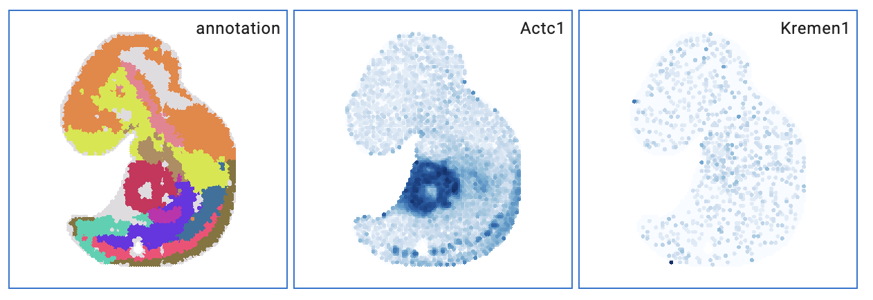
Spatially variable genes (SVGs)
Difference between highly variable genes (HVGs) and spatially variable genes (SVGs)
SVGs are defined as genes with a highly spatially correlated pattern of expression, which varies along with the spatial distribution of a tissue structure of interest
HVGs are defined purely based on molecular features (i.e. gene expression), and do not take any spatial information into account
SVG
non-SVG
Mouse embryo 9.5

Slide 4
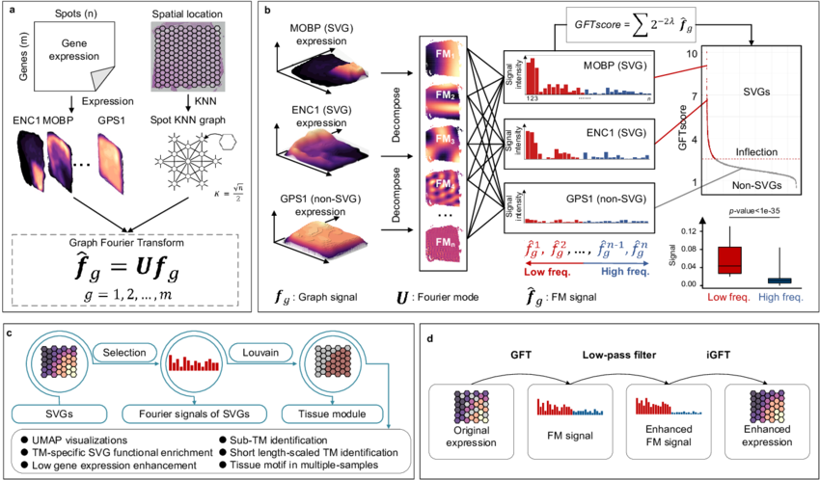
SpaGFT
Python package to analyze tissue functions empowered using spatial omics data
SpaGFT is a hypothesis-free graph Fourier transform framework (GFT) for SVG identification from spatial transcriptomics data without assuming any spatial distribution patterns.
SpaGFT

Slide 5
SpaGFT (2)
Rule: A gene with a high intensity of low-frequency FM signals compared to high-frequency FM signals is typically an SVG, whereas a gene with a low intensity of low-frequency FM signals indicates random expression patterns.
SpaGFT

Slide 6
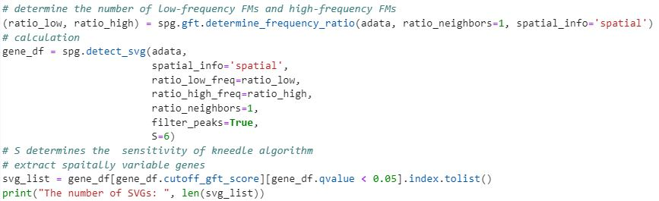
SpaGFT (3)
Implementation:
Tutorial

Slide 7
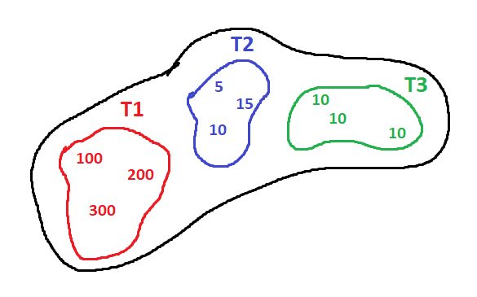
Algorithm: Mean difference value
The idea of this algorithm is that there should be different mean values on tissues which contain SVG and tissues that do not contain it.
For example, the mean value in tissue T1 is 200, while the mean value outside of T1 (in tissues T2 and T3 combined) is 10, and the difference between them is 190, while the mean value in tissue T2 is 10 and outside of the T2 tissue (in tissues T1 and T3) the mean value is 105 and difference between them is 95. Difference should be higher for tissues which contain SVG. In order to use the same threshold for all genes, gene expression should be normalized (this is not done is this simple example).
Mean in T1 is: (100 + 200 + 300) / 3 = 200
Mean outside of T1 is: (5 + 10 + 15 + 10 + 10 + 10) / 6 = 10
Mean in T2 is: (5 + 10 + 15 ) / 3 = 10
Mean outside of T2 is: (100 + 200 + 300 + 10 + 10 + 10) / 6 = 105
Mean in whole organism is: (100 + 200 + 300 + 5 + 10 + 15 + 10 + 10 + 10) / 9 = 73.3
For tissue T1 mean difference value is (200 – 10) / 73.3 = 2.59
For tissue T2 mean difference value is (10 - 105) / 73.3 = -1.26
Value (and absolute value) is much bigger in T1, hence gene might be a SVG which is highly expressed in tissue T1.

Slide 8
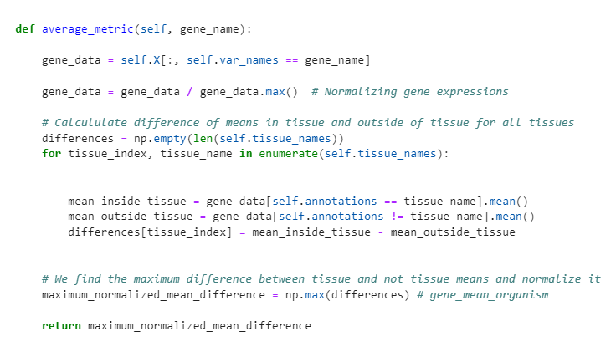
Algorithm: Mean difference value
Implementation:

Slide 9
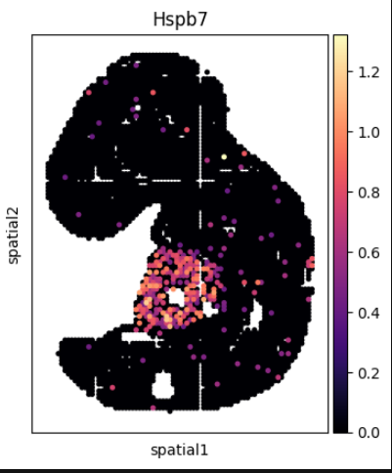
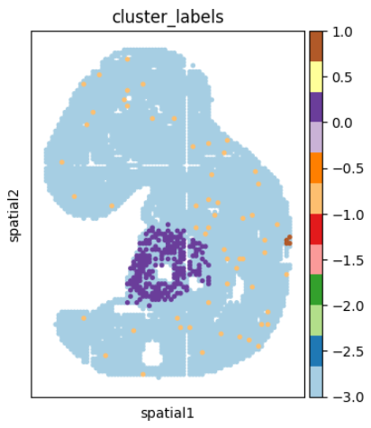
Algorithm: Spatial clustering
This algorithm uses the fact that if a sparse gene (low number of cells) is a SVG its cells are spatially grouped. We can find these groups of nearby cells by clustering cells based on their spatial coordinates.
Groups of cells which are close together are grouped into clusters, while standalone cells are declared as noise. If there are enough cells in a cluster we can claim that gene is a SVG. Furthermore, if there are clusters in most of the tissues we dismiss this gene as it is present in most of the organism.
Genes in heart region have been grouped in purple cluster and the size of this cluster is sufficient to declare this gene a SVG. There is another brown cluster in the Mesenchyme region but its size is to small and it is filtered.
Spatial clustering

Slide 10
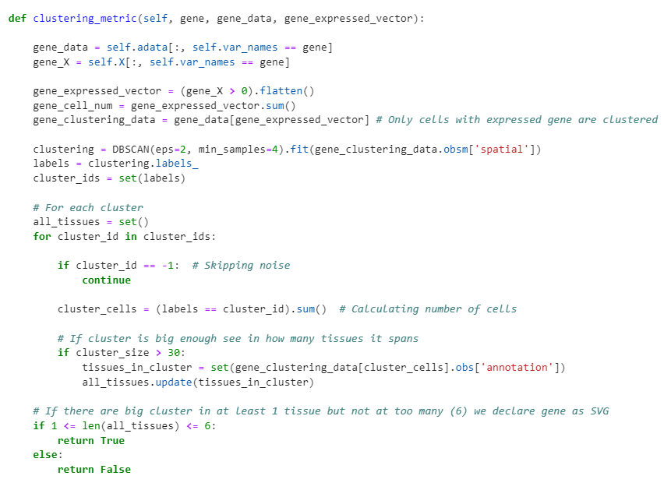
Algorithm: Spatial clustering
Implementation:

Slide 11
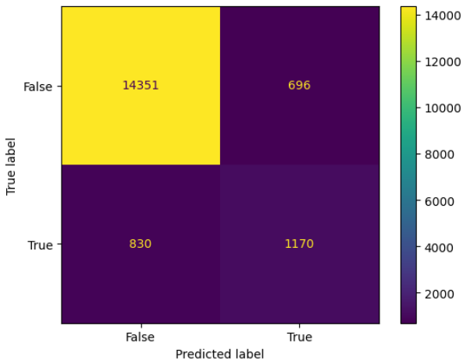
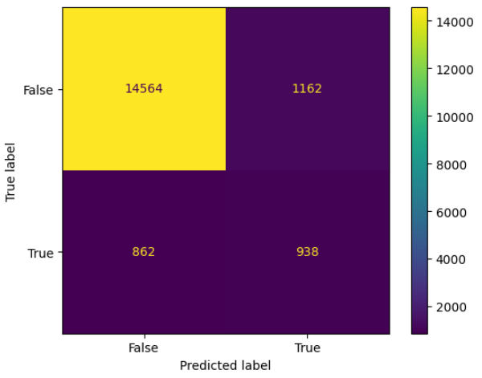
Algorithm: Combination
Mean difference value algorithm has shown to work well on genes with high number of cells, but with lower number of cells it can be very susceptible to noise and small differences in values between tissues. On the other hand, clustering algorithm works only with low number of cells. We can use both algorithms together by using mean difference value on genes with high number of cells and clustering on genes with low number of cells.
Results:
Confusion matrix for embrio
Confusion matrix for brain
 | Mouse embrio | Mouse brain
F1 score | 0.605 | 0.481
AUC | 0.769 | 0.723

Slide 12
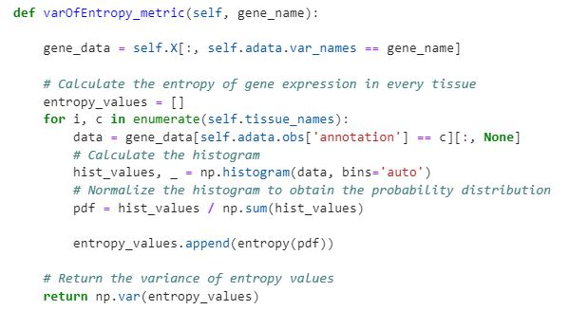
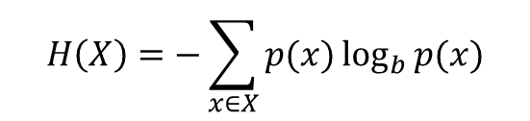
Algorithm: Variance of entropy values
The idea of this algorithm lies in the fact that SVGs are the genes with non-uniform expression across spatial coordinates.
Taking into account that uniform probability yields maximum uncertainty and, therefore, maximum entropy, we have calculated the entropy of gene expression in every tissue.
If the variance of these values is high, it means that there is a difference in the distribution of gene expression across tissues. In other words, this gene is likely to be an SVG.
Implementation:
Entropy:
$$H\left(X\right)=−\sum_{x∈X}{p(x)\log_{b}{p(x)}}$$

Slide 13
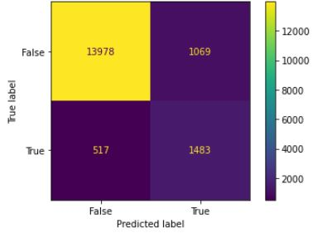
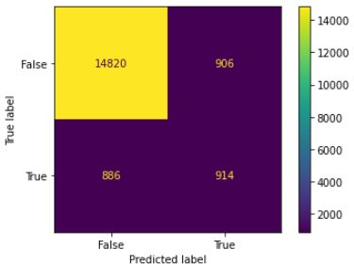
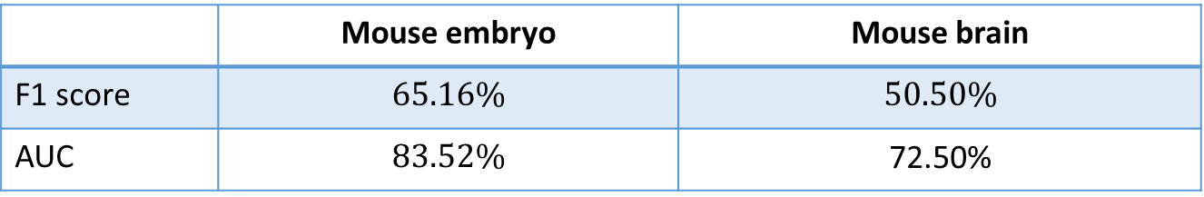
Algorithm: Variance of entropy values
Results:
 | Mouse embryo | Mouse brain
F1 score | $$65.16\%$$ | $$50.50\%$$
AUC | $$83.52\%$$ | $$\text{7}\text{2}\text{.}\text{50}\text{\%}$$

Slide 14
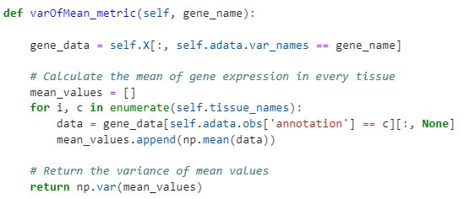
Algorithm: Variance of mean values
The idea of this algorithm was to calculate the mean of gene expression in every tissue and the variance of these values.
If the variance of these values is high, it means that there is a difference in the level of expression across tissues, indicating that this gene is likely to be a SVG.
Implementation:

Slide 15
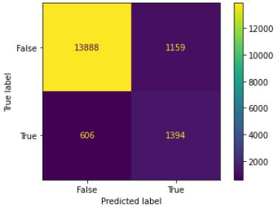
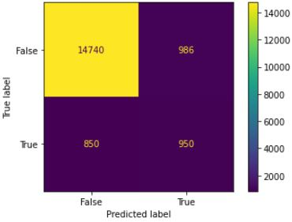
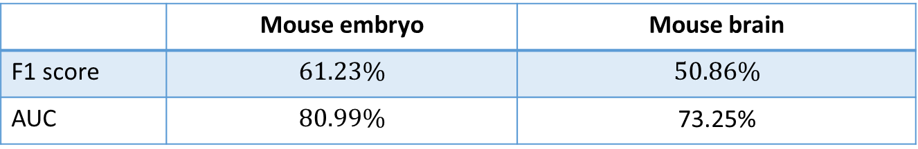
Algorithm: Variance of mean values
Results:
 | Mouse embryo | Mouse brain
F1 score | $$61.23\%$$ | $$50.86\%$$
AUC | $$80.99\%$$ | $$\text{7}\text{3.25}\text{\%}$$

Slide 16
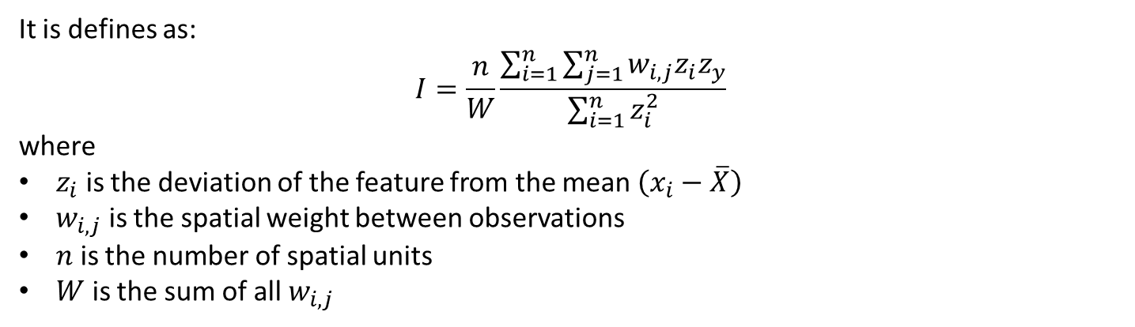
Algorithm: Moran’s I
We have tried one popular approach for the identification of spatially variable genes, which is the Moran's I score.
The Moran's I score is a measure of spatial autocorrelation, which quantifies the correlation of signals, such as gene expression, among observations that are close in space.
It is defines as:
$$I=\frac{n}{W}\frac{\sum_{i=1}^{n}{\sum_{j=1}^{n}{w_{i,j}z_{i}z_{y}}}}{\sum_{i=1}^{n}{z_{i}^{2}}}$$
where
$z_{i}$ is the deviation of the feature from the mean $\left(x_{i}−\overline{X}\right)$
$w_{i,j}$ is the spatial weight between observations
$n$ is the number of spatial units
$W$ is the sum of all $w_{i,j}$

Slide 17
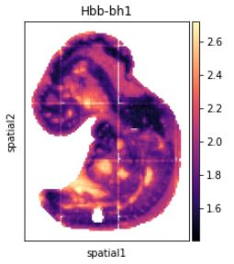

Algorithm: Moran’s I
Implementation:
It can be computed with Squidpy in Python with squidpy.gr.spatial_autocorr() and mode = 'moran‘, but we first need to compute a spatial graph with squidpy.gr.spatial_neighbors()
The method adds a dataframe to adata.uns under the key moranI.
Tutorial

Slide 18
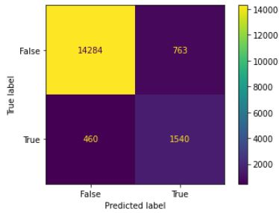
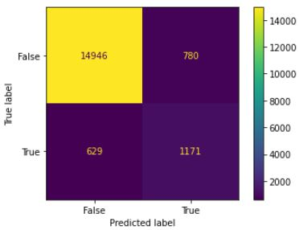
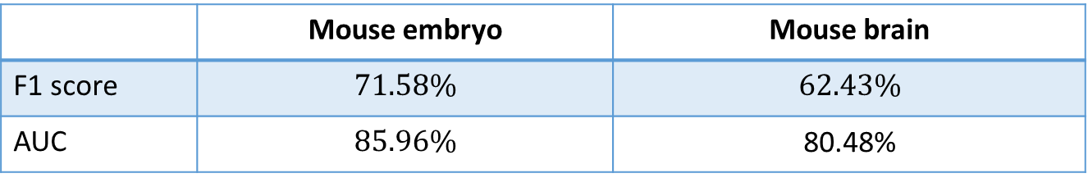
Algorithm: Moran’s I
Results:
 | Mouse embryo | Mouse brain
F1 score | $$71.58\%$$ | $$62.43\%$$
AUC | $$85.96\%$$ | $$\text{80.48\%}$$

Slide 19
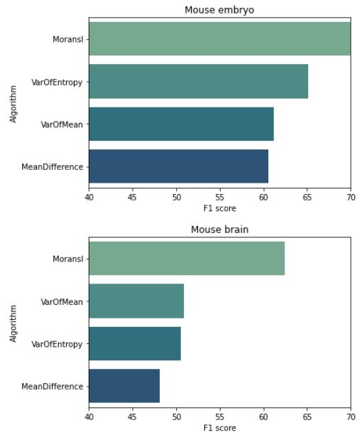
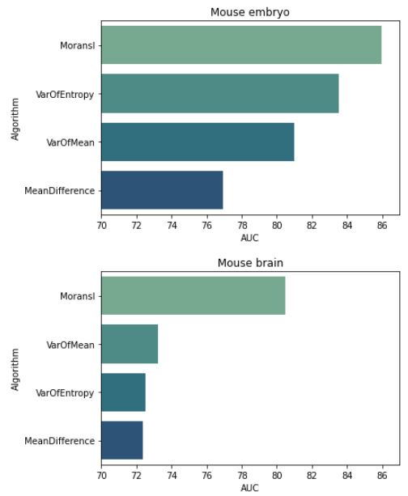
Comparative Overview of Algorithm Results

